Slide 1
GEOM20013: WEEK 3 TUTORIAL

Slide 2
Today’s tutorial
Our Plan
Demonstration
Making a Map
Joins
Assignment 2 overview

Slide 3
Setting up ArcGIS Pro
Make Project in ArcGIS Pro
Change Coordinate System of Map Frame: Right click map > Properties > Coordinate Systems
MGA2020 Zone 55
Save project
Add data into project
Project data (if required)
Do analysis
Make a map (Layout view)

Slide 4
Exercise: Make a Map
Make a Quick map of SA2 Areas
Create new project
Project coordinate system
Add SA2_2016_AUST into ArcGIS Pro
Only show Victoria
Make a quick map with BOLTS and SA2 in different colours

Slide 5
Assignment 2
Census Analysis using GIS
Select a population statistic (age, education, etc.)
Select three SA2 regions to make recommendations to
Compute trend (THE CHANGE IN) between census years (e.g. 2006-2016) for the all of Melbourne or all regional areas
Make a choropleth (colourful) map based on trend values.
Make recommendations to chosen SA2 regions based on trend (e.g build more schools)

Slide 6
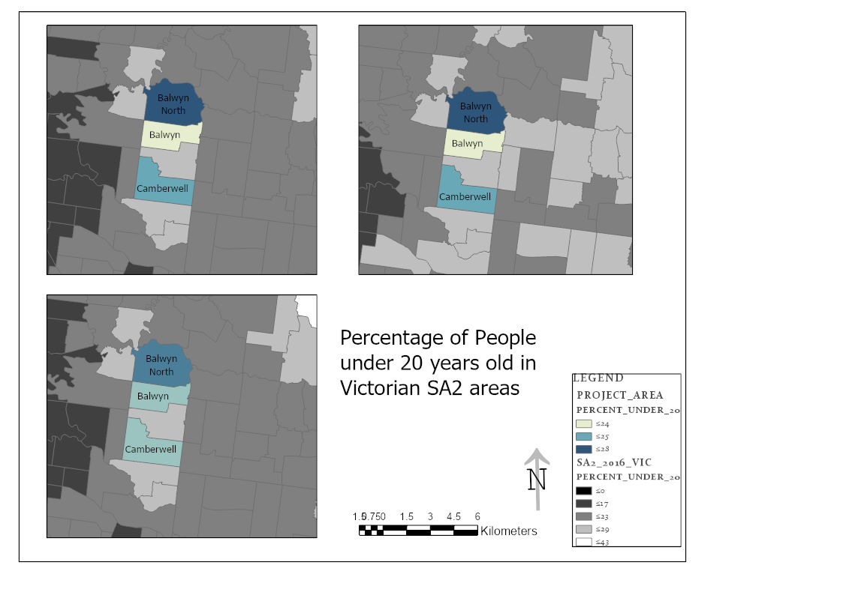
Assignment 2: Census GIS examples

Slide 7
Assignment 2: Census GIS examples

Slide 8
Assignment 2: Census GIS examples

Slide 9
Assignment 2: Census GIS

Slide 10
Assignment 2
What to do?
Firstly get the CSV table data
Look at:
Datapacks > 2016_TSP_SA2_for_Vic_short-header > Metdata > 2016_TSP_Sequential_Template.xlsx
and Metadata_2016_TSP_DataPack.xlsx
These will tell you which CSV files to add for the trend you want to analyse. Will also help in choosing a trend.
Choose appropriate CSV in folder:
2016 Census TSP Statistical Area 2 for VIC

Slide 11
Assignment 2
What to do?
Add CSV into ArcGIS Pro
Join CSV table to SA2 Victoria polygon
Compute Trend:
Select only required columns
Add new field (e.g percentage change)
Compute percentage change: (2016 Stat Val) – (2006 Stat Val) / (2006 Stat Val) * 100
Can do for multiple years or statistic values based on analysis
INSTRUCTIONS: LMS> Assessment > A2_Workflow.pdf

